Slide 1
Create a Student class {fields: private: String name, double Marks; Methods: parameterize constructor, String genrateMarksReport(Struent[ ]),
void display(String)}. Note ‘name’ field is the combination of first name followed by space followed by last name. Now create a public class useStudent which creates an array of object of size 3 of Student class in the main method by calling paramterize constructor. Main method also performs following operations:
genrateMarksReport(Strudent [ [) which extracts the last name from the name field all students and then merges it with their corresponding marks and returns it
ii) Invokes display(String) method to display the “report string” returned by GenerateMarksReport(…)

Slide 2
class Student{
private String strName;
private double dMarks;
Student(String N, double M){
strName = N;
dMarks = M;
}
String getName(){
return strName;
}
static void display(String str){
System.out.print(str);
}
}
static String generateMarksReport(Student[ ] objStudArr){
boolean bFound = false;
String strLastName="";
String strLastNamePMarks = " ";
String strAllStudLNPM = " ";
for(int i=0; i < objStudArr.length; ++i) {
for(int j=0; j<objStudArr[i].strName.length(); ++j){
if(objStudArr[i].strName.charAt(j)==' '){
bFound = true;
continue;
}
if(bFound){
strLastName = strLastName + objStudArr[i].strName.charAt(j);
}
}
//JOptionPane.showMessageDialog(null, strLastName);
strLastNamePMarks = strLastName + " " +objStudArr[i].dMarks;
strAllStudLNPM = strAllStudLNPM + "\n" +strLastNamePMarks ;
strLastName = " ";
bFound=false;
}
JOptionPane.showMessageDialog(null, strAllStudLNPM);
return strAllStudLNPM;
}

Slide 3
public class UseStudentArrOfObj {
public static void main(String[] args) {
Student[] objArrStudent = new Student[3];
String strN ="TTU Lubbock";
for(int i=0; i<objArrStudent.length;++i){
strN =strN + i;
double dM = 60.0+i;
objArrStudent[i] = new Student(strN,dM);
strN = "TTU Lubbock";
}
String strReport = Student.generateMarksReport(objArrStudent);
Student.display(strReport);
}
}

Slide 4
class Test {
protected int x, y;
}
class Main {
public static void main(String args[]) {
Test t = new Test();
System.out.println(t.x + " " + t.y);
}
}

Slide 5
class Test {
public static void main(String[] args) {
for(int i = 0; 1; i++) {
System.out.println("Hello");
break;
}
}
}

Slide 6
class Main {
public static void main(String args[]) {
System.out.println(fun());
}
int fun() {
return 20;
}
}

Slide 7
class Test {
public static void main(String args[]) {
System.out.println(fun());
}
static int fun() {
static int x= 0;
return ++x;
}
}

Slide 8
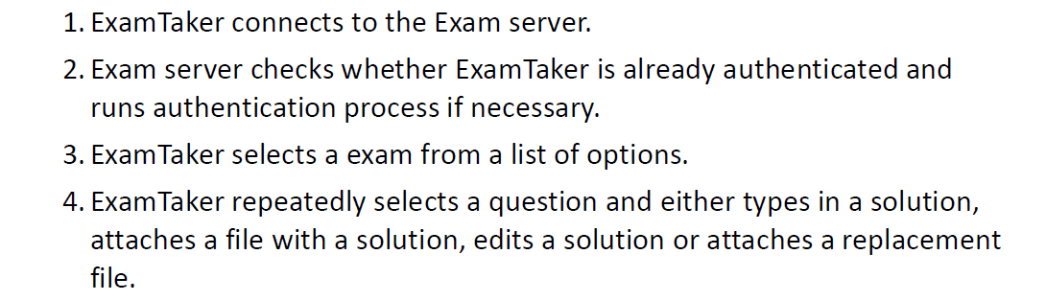

Slide 9
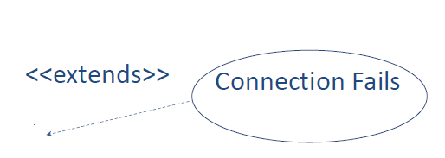
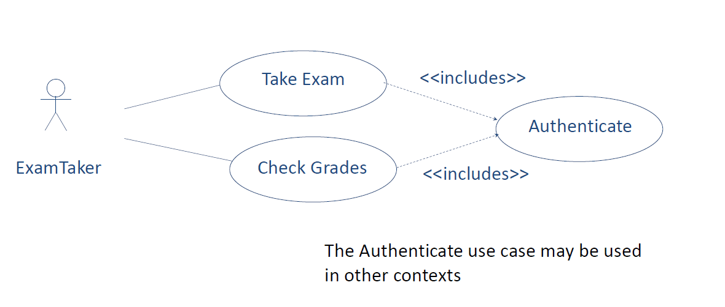

Slide 10
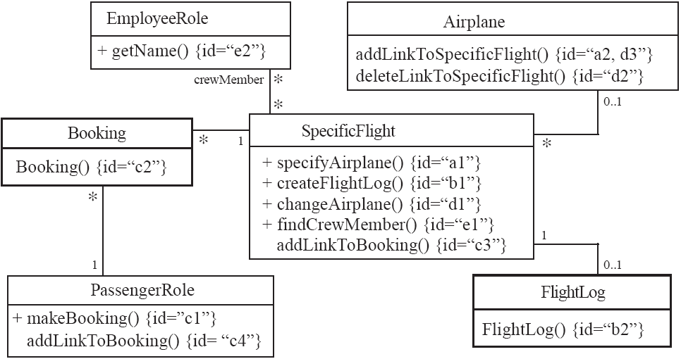
Creating a new regular flight
Searching for a flight
Modifying attributes of a flight
Creating a specific flight
Booking a passenger
Canceling a booking

Slide 11
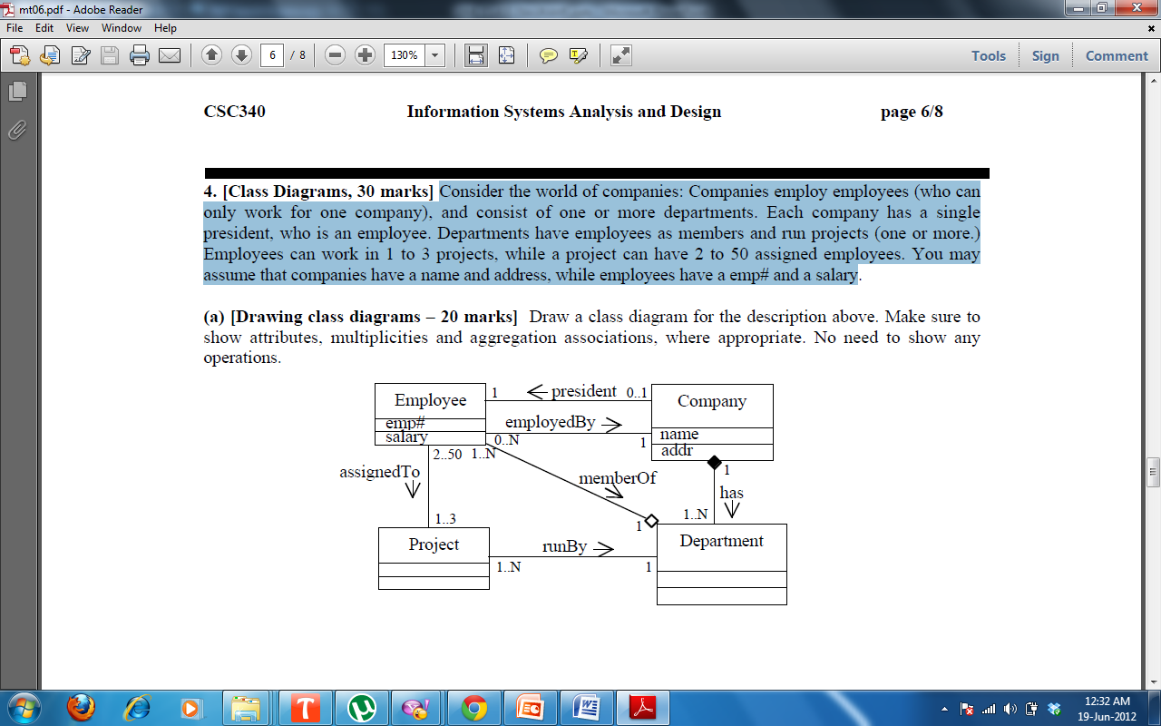
Consider the world of companies:
Companies employ employees (who can only work for one company), and consist of one or more departments.
Each company has a single president, who is an employee.
Departments have employees as members and run projects (one or more.)
Employees can work in 1 to 3 projects, while a project can have 2 to 50 assigned employees.
You may assume that companies have a name and address, while employees have a emp# and a salary
Design a Class Diagram

